Slide 1


ALTSCHOOL OF Cybersecurity (BARAKA 2025)
MONTH 2 – WEEK 3

Slide 2
Refresher- Last week
Introduction to Networks and Network Models
  Introduction to Networks and Networking Models (OSI, TCP/IP)
  Importance and Components of Networks
  Types of Networks
  A Day in the Life –Learning Networks
  Network Models –OSI and TCP/IP
Network Topologies and Network Devices
  Network Topologies (Bus, Star, Ring, Mesh, Hybrid)
  Networking Devices – Routers, Switches, Hubs

Slide 3
MONTH 2 - WEEK 3
IP Address Fundamentals
  Understanding Internet Protocol v4 (IPV4) and Structure
  Understanding Binary Format in IP addresses
Subnet and IPv4 Addresses
  What is a Subnet?
  Classes of IPv4 Addresses
  Subnet Mask and IPv4 Addresses
  Subnet Mask and Subnetting Techniques
  Classless Inter-Domain Routing (CIDR) Notation and Variable Length Subnet Mask
  Class Demo

Slide 4
Understanding Internet Protocol v4 (IPV4) and Structure
Day 1

Slide 5

Internet protocol
It is a network layer (OSI - layer 3) protocol in the Internet Protocol suite (also known as TCP/IP) used for forwarding packet streams and datagrams across networks. To put it very simply: it provides everyone with a unified way of addressing (by assigning IP addresses to devices) which allows users in different networks to communicate. And communication between different networks is, after all, the underlying principle of the internet (hence the name: inter means “between” and net is short for “network”).

Slide 6
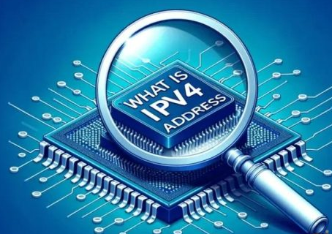
Internet protocol V4 – IPV4
Internet Protocol Version 4 (IPv4) is the fourth version of the Internet Protocol and is the most widely used protocol for data communication across different types of networks.
IPv4 is a connectionless protocol used in packet-switched networks, such as Ethernet. It provides a logical connection between network devices by providing an identifier for each device. There are many ways to configure IPv4 with all types of devices – including both manual and automatic configuration – depending on the type of network.

Slide 7
How Does IPv4 Work?
Addressing
  Each device on an IPv4 network has a unique 32-bit address, typically written in dotted-decimal notation (e.g., 192.168.1.2). This address acts like a street address, identifying the device’s location on the network.
Packet Fragmentation
    Data is sent in chunks called packets. If a packet is too large to fit through a network link, it’s fragmented into smaller pieces. Each fragment carries the original address and information about its order within the whole packet.

Slide 8
How Does IPv4 Work?
Routing
  When a device sends a packet, it consults a routing table. This table contains information about how to reach different networks based on their addresses. The device forwards the packet to the next router on the path towards its destination.
Routing and Forwarding
    Routers are the traffic cops of the internet. They receive packets, check their destination addresses against their routing tables, and then forward them to the next router or directly to the recipient device.

Slide 9
How Does IPv4 Work?
Reassembly
  Fragmented packets eventually reach their destination device. The device reassembles them in the correct order based on the information inside each fragment, forming the original data sent.
  Error Checking
    Each packet contains a checksum, a calculated value used to detect errors during transmission. If the checksum received at the destination doesn’t match the original, the packet is discarded and re-requested.

Slide 10
How Does IPv4 Work?
Protocols
  IPv4 works alongside other protocols like TCP (Transmission Control Protocol) and UDP (User Datagram Protocol). TCP ensures reliable delivery of data by acknowledging receipt and retransmitting lost packets. UDP prioritizes speed over reliability, making it suitable for real-time applications like streaming.
  Error Checking
    Each packet contains a checksum, a calculated value used to detect errors during transmission. If the checksum received at the destination doesn’t match the original, the packet is discarded and re-requested.

Slide 11

STRUCTURE OF Internet protocol V4 – IPV4
An IPv4 address is a 32-bit numerical label assigned to each device (e.g., computer, printer) participating in a computer network using the Internet Protocol (IP). It’s like a unique street address for your device on the internet.
The structure of an IPv4 address: 32-bits

Slide 12
STRUCTURE OF Internet protocol V4 – IPV4
The 32-bits structure of an IPv4 address is divided into four octets (bytes) of eight bits each (4x8), written in decimal form and separated by periods.
It is relatively easy to translate a decimal IPv4 address to its binary form and vice versa. Any octet consists of eight bits, to which a particular number is assigned, from left to right: 128, 64, 32, 16, 8, 4, 2, 1. The trick is to add these numbers – starting from the highest possible ones – to arrive at the decimal value. One means the number is there, zero – that it isn’t. So for “172” this would be 128 + 32 + 8 + 4 = 172, which in binary translates to “10101100.” As you can count quickly, the possible range for decimal values is 0 to 255.

Slide 13
STRUCTURE OF Internet protocol V4 – IPV4
For example, the address 172.168.1.2 would be represented as four bytes:
  10101100
  10101000
  00000001
  00000010

Slide 14
STRUCTURE OF Internet protocol V4 – IPV4
These 32 bits are further divided into two parts:
  Network portion: Identifies the network to which the device belongs. The number of bits used for the network portion depends on the subnet mask. Generally, the more devices on a network, the more bits are needed for the network portion.
  Host portion: Identifies the specific device within the network. The remaining bits after the network portion are used for the host portion.

Slide 15
STRUCTURE OF Internet protocol V4 – IPV4
Dotted Decimal Notation
This is the most common way to write IPv4 addresses. It uses four decimal numbers between 0 and 255, separated by periods. For example, the address 192.168.1.2 is written in dotted decimal notation.
Special Addresses
0.0.0.0: Represents the default route or “all hosts” within a network.
255.255.255.255: Represents the broadcast address and is used to send data to all devices on a network.

Slide 16
Understanding Binary Format in IP addresses
Day 1

Slide 17
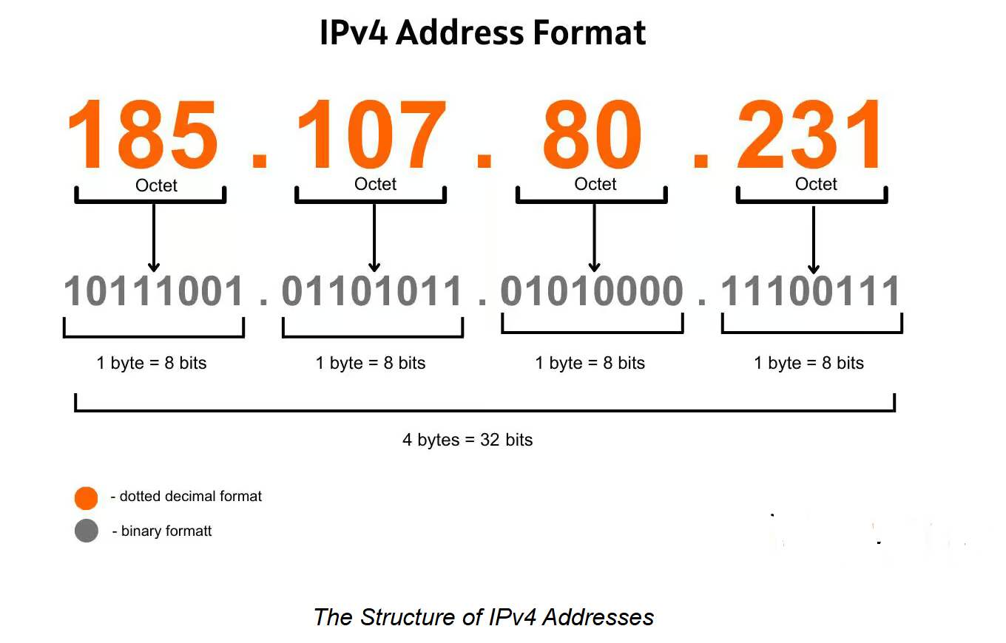
STRUCTURE OF Internet protocol V4 – IPV4

Slide 18
Subnet and IPv4 Addresses
Day 1

Slide 19
IP ADDRESS subnetTING
IP address subnetting is a method used to divide a single IP address block into several smaller, more manageable groups. But why is this division necessary? It is primarily used to improve network performance and efficiency, enhance security, and facilitate organizational control over its network resources. Each subnet acts like its own miniature network, improving routing efficiency and reducing network congestion.

Slide 20
IP ADDRESS subnetTING
An IP address is typically shown in a decimal format (like 192.168.1.1) for human readability. However, under the surface, computers interpret this address in binary form (11000000.10101000.00000001.00000001). The transformation from a user-friendly decimal form to binary happens behind the scenes, powering the logic used in subnetting.

Slide 21
IP ADDRESS subnetTING
To differentiate between what part of the IP address refers to the network and which part refers to the host, subnet masks are used. Subnet masks are also expressed in binary and determine how the IP address is divided. A common subnet mask, like 255.255.255.0, told in binary, is 11111111.11111111.11111111.00000000.
This mask says that the first three octets (24 bits) represent the network portion, and the last octet (8 bits) is for host devices.

Slide 22
IP ADDRESS subnetTING
An IP address is typically shown in a decimal format (like 192.168.1.1) for human readability. However, under the surface, computers interpret this address in binary form (11000000.10101000.00000001.00000001). The transformation from a user-friendly decimal form to binary happens behind the scenes, powering the logic used in subnetting.

Slide 23
a subnet
A subnet defines the number of bits, out of 32, used for the "network portion" of the address. Subnet masks can also be defined in a more common 'slash' representation called CIDR notation.

Slide 24
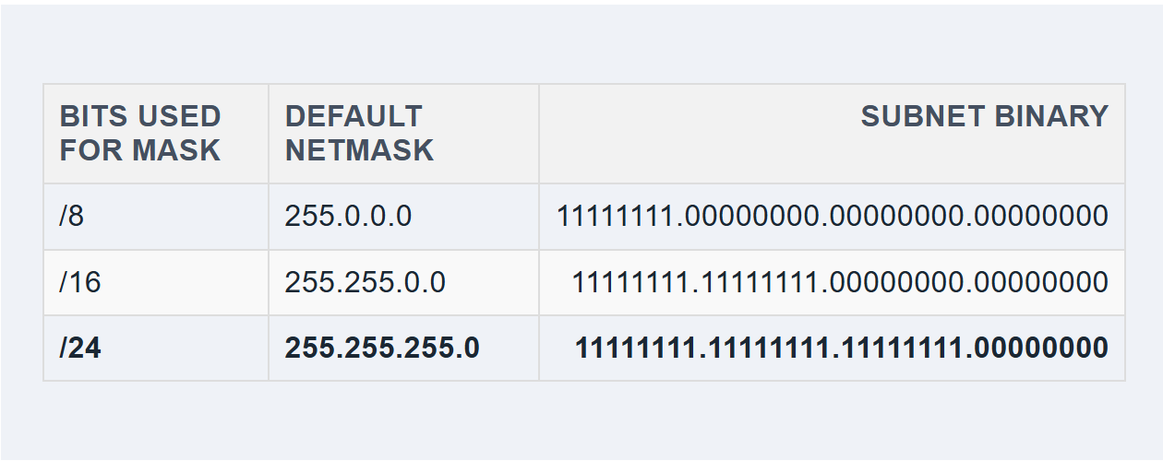
IP ADDRESS subnetTING
In the following table, the red digits represent the bits used for the network. The black digits will be used for device IP addresses. Note that the 255.0.0.0 mask can also be represented as a '/8' because it reserves 8 bits of the overall 32 bits used to describe an IPv4 address as the network portion.

Slide 25
IP ADDRESS subnetTING
For example, you might have a network with devices (known as hosts) with the following IP addresses:
Network: 172.16.56.0
Computer 1: 172.16.56.40
Computer 2: 172.16.56.55
Printer 1: 172.16.56.100
In this case, the network uses 24 bits (or three octets). Notice that every host device in the network has the same first three octets. That's the network portion of the IP address with a /24 mask.
IP address: 172.16.56.40
Mask: 255.255.255.0
Binary mask: 11111111.11111111.11111111.00000000

Slide 26
IP ADDRESS subnetTING
The last octet is the host portion of the IP address. That's where you'd assign your devices. In this case, you could assign up to 254 hosts. (More on that later.)
IP address: 172.16.56.40
Mask: 255.255.255.0
Binary mask: 11111111.11111111.11111111.00000000

Slide 27
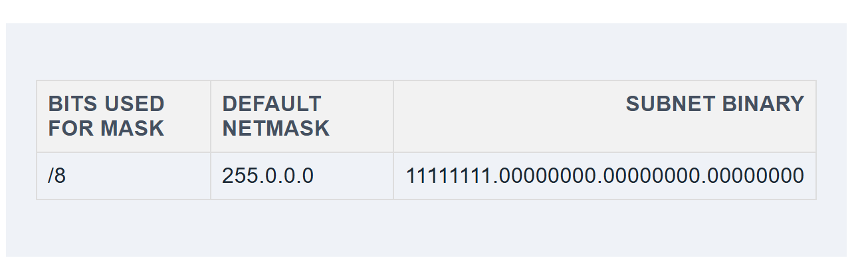
IP ADDRESS subnetTING
If it were an /8 network, then only the first octet would be the network portion.

Slide 28
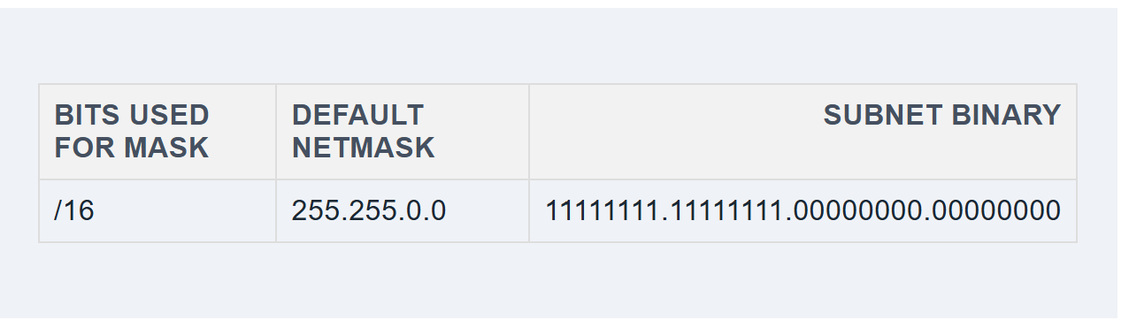
IP ADDRESS subnetTING
Let's look at the table again. If it were /16, the first two octets would be the network portion, and the host portion would occupy the last two octets.

Slide 29
Subnet and IPv4 Addresses
Day 1

Slide 30
Refresher- Last CLASS (DAY 1)
IP Address Fundamentals
  Understanding Internet Protocol v4 (IPV4) and Structure
  Understanding Binary Format in IP addresses
Subnet and IPv4 Addresses
  What is a Subnet?

Slide 31
MONTH 2 - WEEK 3 (DAY 2)
Subnet and IPv4 Addresses
  What is a Subnet?
  Classes of IPv4 Addresses
  Subnet Mask and IPv4 Addresses
  Subnet Mask and Subnetting Techniques
  Classless Inter-Domain Routing (CIDR) Notation and Variable Length Subnet Mask
  Class demonstration

Slide 32
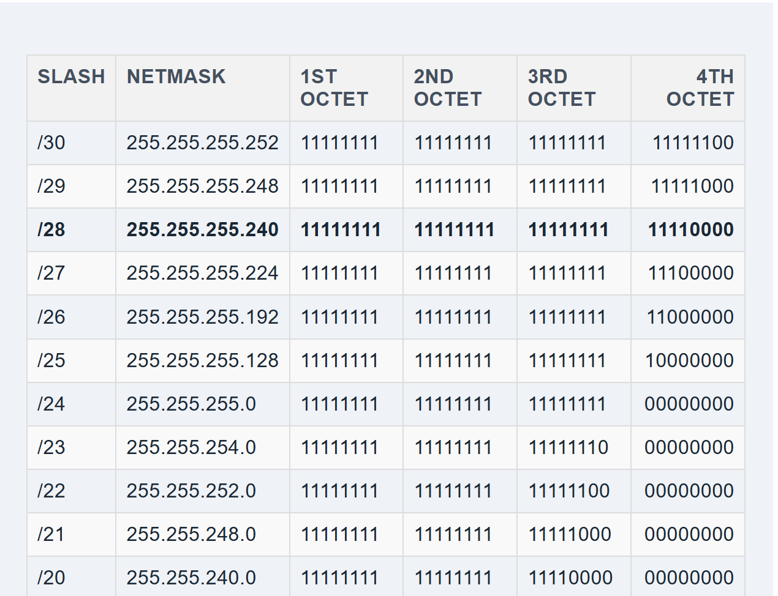
IP ADDRESS subnetTING
Here's what the full subnet mask table looks like. In this table, 1s represent the network portion, and 0s represent the host portion

Slide 33
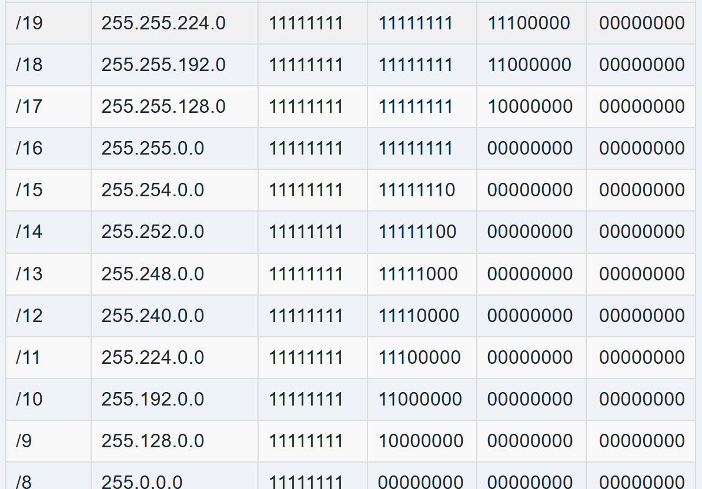
IP ADDRESS subnetTING
Here's what the full subnet mask table looks like. In this table, 1s represent the network portion, and 0s represent the host portion

Slide 34
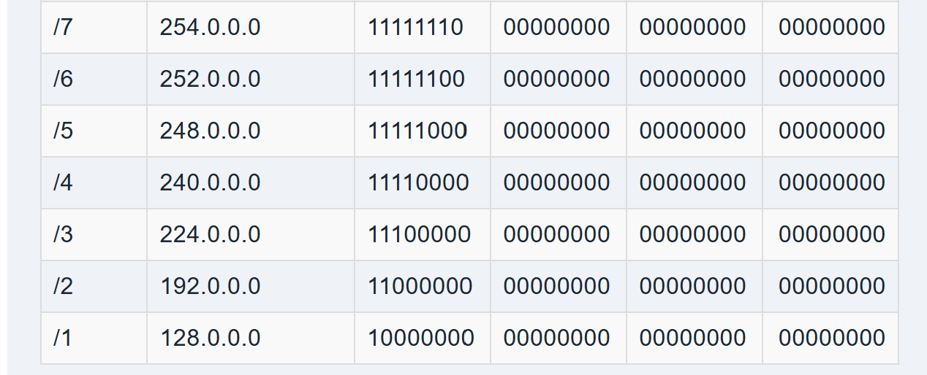
IP ADDRESS subnetTING
Here's what the full subnet mask table looks like. In this table, 1s represent the network portion, and 0s represent the host portion

Slide 35

What are IP Address Classes?
IP addresses have five classes, but only three are applicable to subnetting — A, B, C.
Here are the IP address ranges by class:
Class A = 1.0.0.0 to 127.0.0.0
Class B = 128.0.0.0 to 191.255.0.0
Class C = 192.0.0.0 to 223.255.255.0
Class D = 224.0.0.0 to 239.255.255.0
Class E = 240.0.0.0 to 254.255.255.0

Slide 36
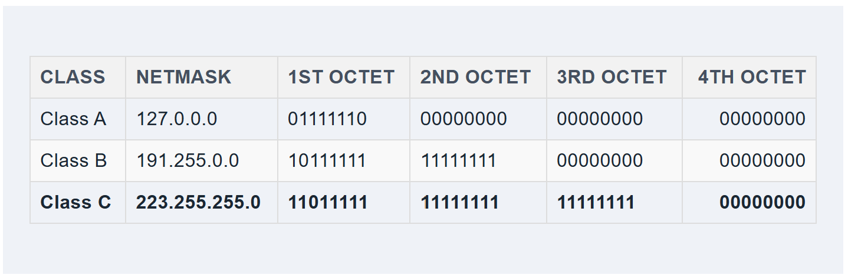
IP Address Classes
Remember, these IP addresses are represented in binary.
Here are the largest subnet IP addresses in these ranges:

Slide 37
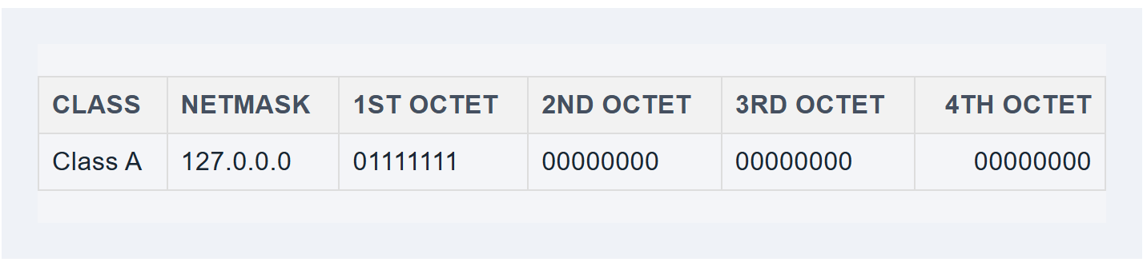
IP Address Classes
This IP classes are important because it affects the number of hosts and subnets available in a network.
Notice that Class A addresses provide the most room for host addresses (the black digits). That's because the network portion only occupies the first octet. Most large enterprises use Class A IP addresses for this reason. You can connect more devices to a Class A network than a Class C.

Slide 38
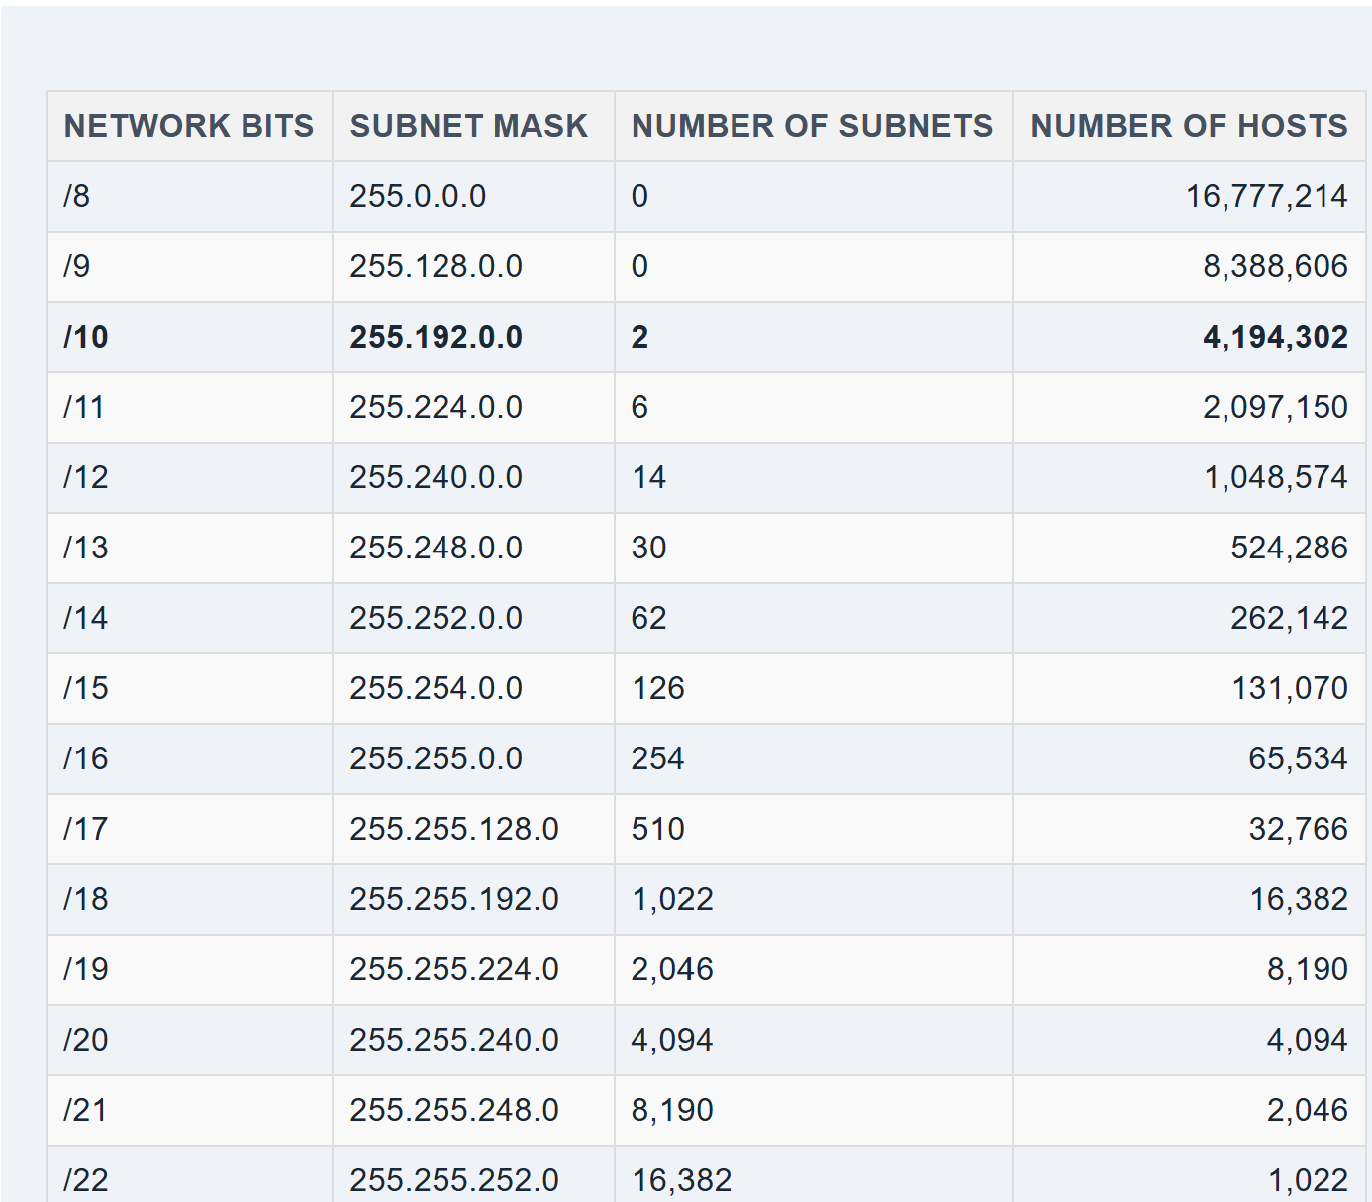
IP Address Classes AND SUBNET MASK
In every class, you can steal bits from the hosts to create more subnets but also reduce the number of hosts. Notice how stealing just one bit for the network significantly drops the number of hosts.
Class A Subnet mask and host

Slide 39
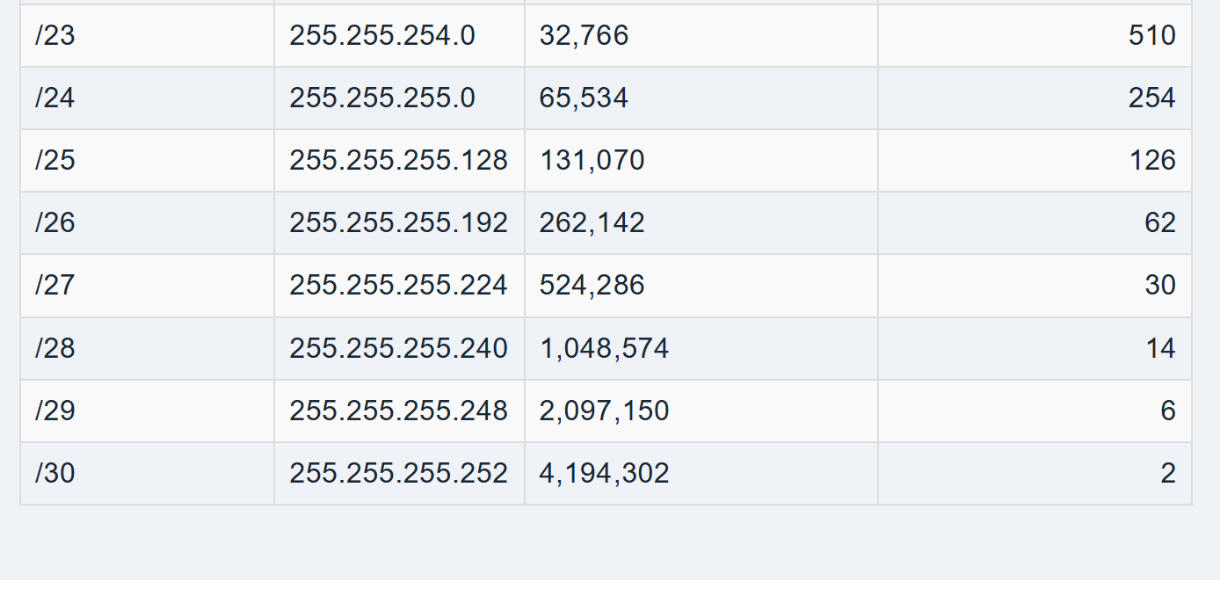
IP Address Classes AND SUBNET MASK
Class A Subnet mask and host

Slide 40
IP Address Classes AND SUBNET MASK
Class A Subnet mask and host

Slide 41
IP Address Classes AND SUBNET MASK
Class A Subnet mask and host

Slide 42
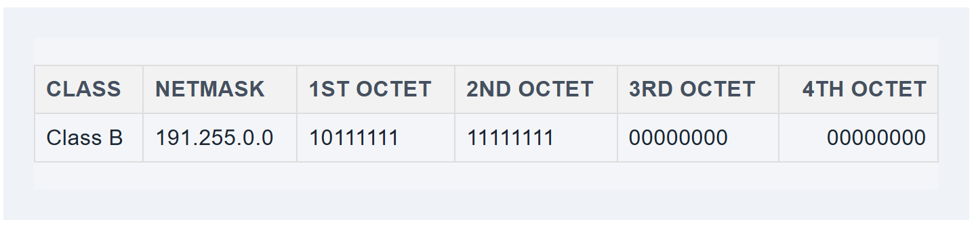
IP Address Classes AND SUBNET MASK –CLASS B
Class B IP addresses offer fewer hosts than Class A because its network portion occupies the first two octets.

Slide 43
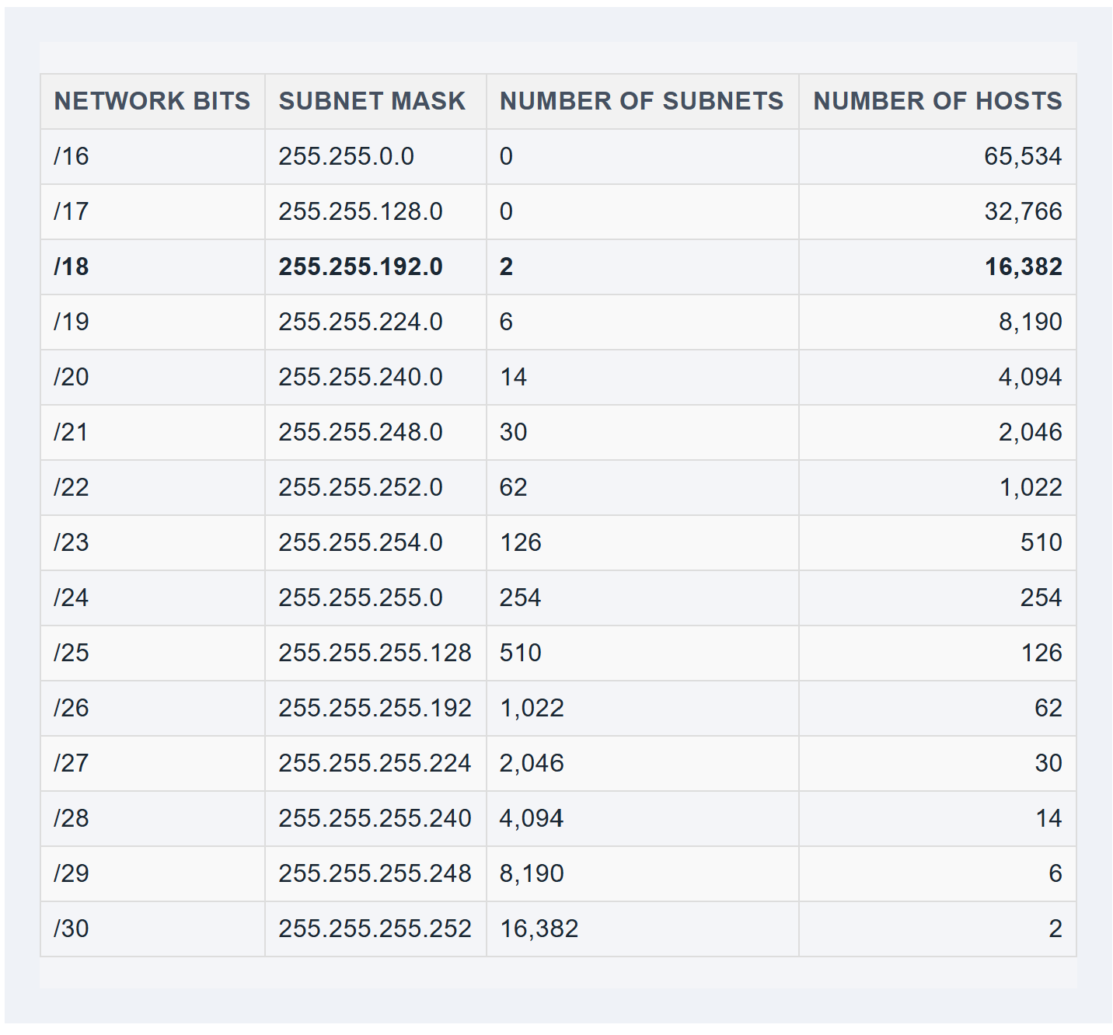
IP Address Classes AND SUBNET MASK –CLASS B
Class B Subnet mask and host

Slide 44
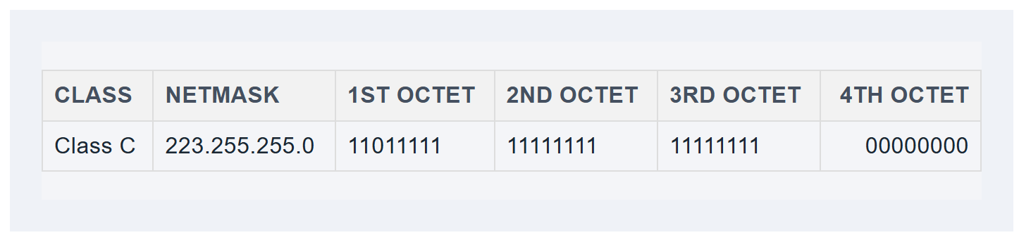
IP Address Classes AND SUBNET MASK –CLASS C
Class C IP addresses offer the fewest hosts because the network portion occupies three octets.
You might notice that your home router's default IP address falls into the Class C category. This special subnet is reserved for private IP addresses; you can read why in the Network Address Translation article.

Slide 45
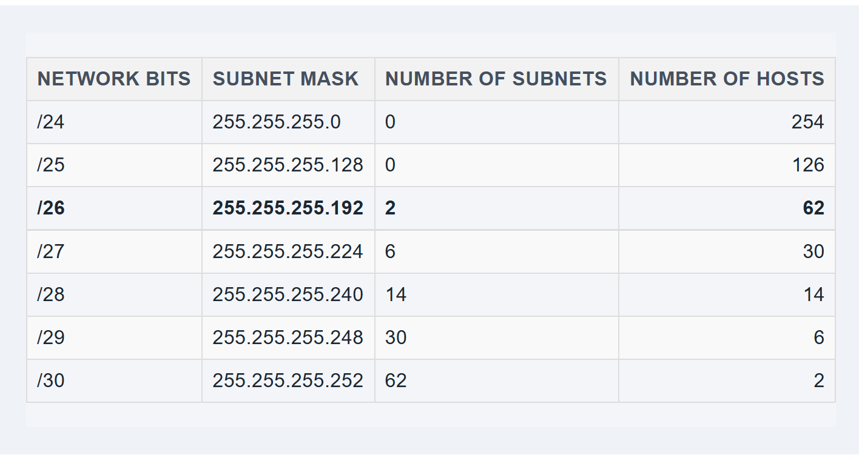
IP Address Classes AND SUBNET MASK –CLASS C
Class C Subnet mask and host

Slide 46
IP Address Classes AND SUBNET MASK –CLASS C
Class C IP addresses offer the fewest hosts because the network portion occupies three octets.
You might notice that your home router's default IP address falls into the Class C category. This special subnet is reserved for private IP addresses; you can read why in the Network Address Translation article.
These standards make subnetting a little easier. For example, if you choose a Class 'C' address, you know it uses at least 24 bits (/24) of the 32 available bits for the network portion of the address

Slide 47
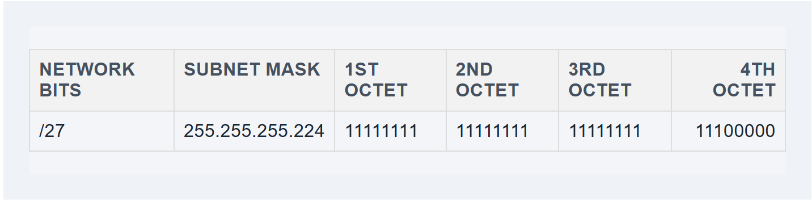
How to Subnet in IPv4
Now that we know about classes, binary, and subnets. Let's dive into a subnet.
Here's the IP address we'll use: 43.17.255.71/27
Here's what it looks like in binary:
00101011.00010001.111111.01000111
From the IP address, we already know two things:
It's a Class A IP Address
It must have at least eight network bits, but we're giving it 27 bits
In that case, we know the network portion of the subnet will occupy these bits:

Slide 48
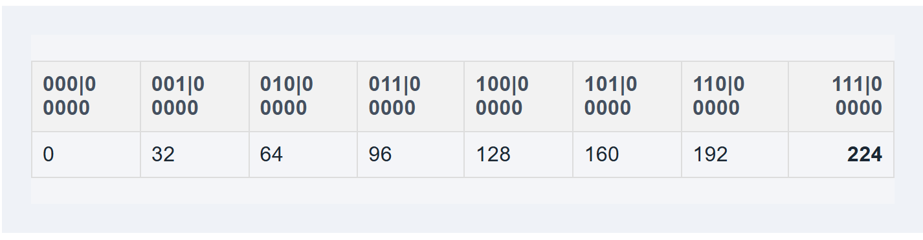
How to Subnet in IPv4
Let's reverse engineer this last octet to determine the network portion of the address or what the subnet is for this address.
Here's what we want to do:
Determine the number of allowed subnets using the /27 network mask
Determine what subnet the address lies in
Here's an example:
**This gives us eight possible subnets with the /27 mask.

Slide 49
How to Subnet in IPv4
Let's reverse engineer this last octet to determine the network portion of the address or what the subnet is for this address.
Here's what we want to do:
1, Determine the number of allowed subnets using the /27 network mask
2, Determine what subnet the address lies in
Here's an example:
**This gives us eight possible subnets with the /27 mask.

Slide 50
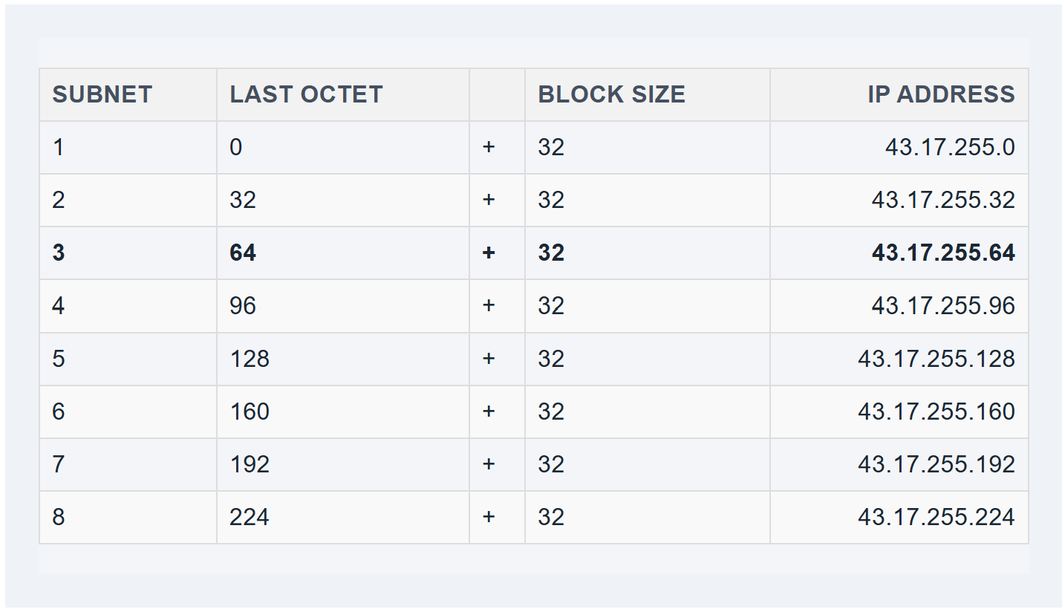
How to Subnet in IPv4
How to determine what subnet your IP address lives
Now, let's find the subnet address where this IP address resides.
Remember that the IP address is 43.17.255.71
We are only looking at the last octet because the first three octets are the network portion.
43.17.255.71
We just have to take a look at our table again. 71 falls above the 43.17.255.64 subnet and below the 43.17.255.96 subnet.
So it belongs in the 43.17.255.64 subnet.
We now have the subnet for 43.17.255.71: 43.17.255.64.

Slide 51
Classless Inter-Domain Routing (CIDR) Notation
CIDR (Classless Inter-Domain Routing) is a method used to efficiently allocate IP addresses on a network. CIDR allows network administrators to create subnets by allocating IP addresses based on size and need. This enhances the security, organization, and efficiency of the network.
CIDR also incorporates concepts such as IP addresses, subnetting, and route table management — all of which we will go over in detail. But first, let’s delve into CIDR notation and all its benefits.

Slide 52
Classless Inter-Domain Routing (CIDR) Notation
CIDR notation is a concise method to represent an IP address and its associated network prefix. The core part signifies the network prefix, while the CIDR suffix determines the variation or available addresses.
All IPv4 addresses are 32 bits, which can be broken up into 4 bytes, so the CIDR suffix informs the reader how many bits are already allocated. The full form of CIDR suffix will never be higher than 32 since that would be larger than the IP address itself.

Slide 53
CIDR Notation - SYNTAX
192.168.1.0/24
IP Address: Everything before the slash is the network IP address. All IP addresses will be a variation of the 192.168.1.X, where X is the host.
CIDR Notation: The slash and everything after it is the CIDR notation. The 24 represents the number of bits that are allocated to the IP addresses. Find the difference between 32 and 24 to determine how many bits are available for allocation.
Prefix: The network prefix is 192.168.1. These three octets are reserved and will remain unchanged throughout the IP allocation process.
Host: The host, part of the IP address ("0" in this example), is the section that identifies specific devices within the network. In this case, the last 8 bits (as determined by the "/24" CIDR notation) are available for different hosts on this network, allowing for 256 unique host addresses (2^8 = 256).

Slide 54
CIDR Notation - SYNTAX
192.168.1.0/24
To bring the point home, the available IP addresses for this CIDR notation would be:
192.168.1.0
192.168.1.1
…
192.168.1.254
192.168.1.255
This is calculated by taking the CIDR suffix, subtracting it by 32, and then raising 2 to the power of that number.
Example: 32-24 = 8. 2^8 = 256. With a zero-based index, that is why it ends at 255. Therefore, there are 255 available IP addresses in this CIDR notation.

Slide 55
What are the Benefits of CIDR Notation?
CIDR notation reduces the size of your routing table by grouping IP addresses by similar prefixes. CIDR’s convenient notation reduces the complexity of IP allocation and frees up network engineer’s time to work on other issues.
It also facilitates Variable Length Subnet Masking (VLSM), which allows administrators to create subnets of varying sizes based on CIDR blocks. Ultimately, CIDR notations' core benefits rest on its ability to conveniently illustrate IP allocation.

Slide 56
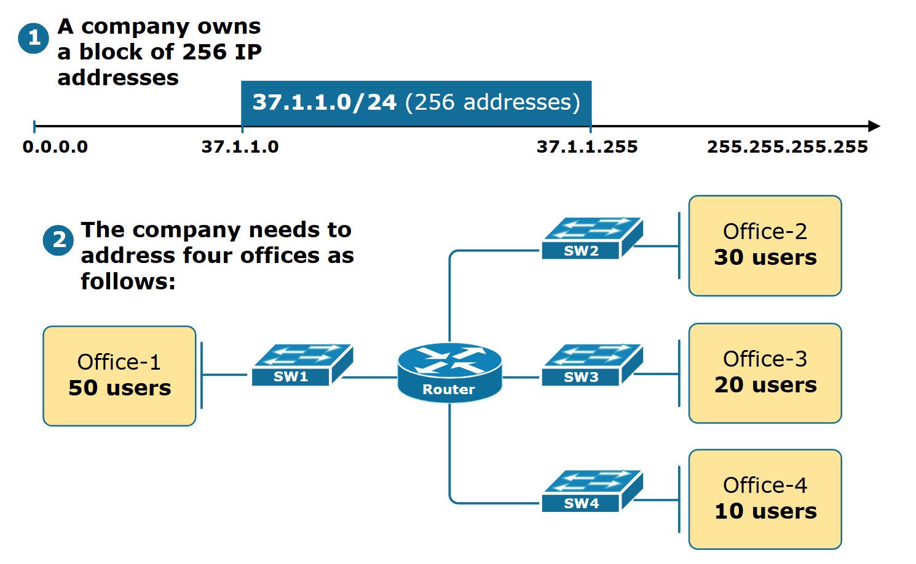
Variable Length Subnet Masking (VLSM)
To understand what Variable Length Subnet Masking (VLSM) is, let's go through a business example. Suppose a company has bought the IP address range 37.1.1.0/24 (256 addresses). The company has 5 offices, as shown in figure 1 below:

Slide 57
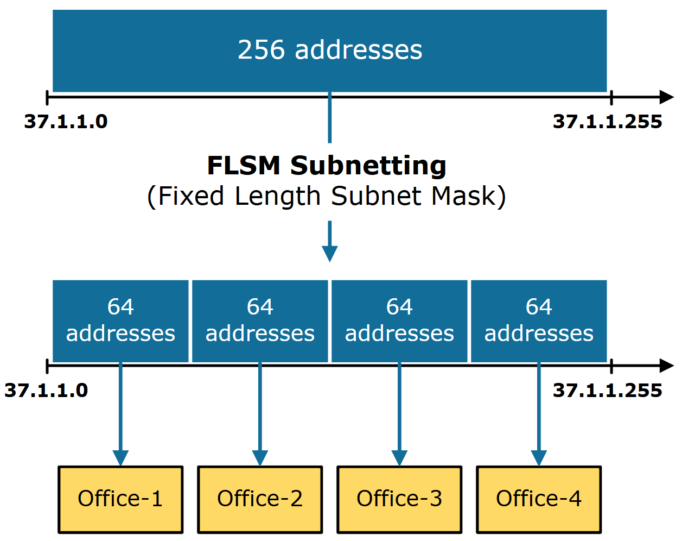
Variable Length Subnet Masking (VLSM)
We are tasked to subnet the 37.1.1.0/24 IP address block and assign each office an IP subnet. Let's see what the two ways to do this are.
The first approach to this task is to divide the 256-address block into four equal-sized subnets. This technique is called Fixed Length Subnet Mask (FLSM). The benefit of this approach is that all subnets have the same subnet mask, which makes the process very straightforward and less prone to errors. Figure 2 below illustrates this example.

Slide 58
Variable Length Subnet Masking (VLSM)
However, this method results in a significant waste of IP addresses. For example, office-4 has only 10 users, but we assign a subnet with 64 IP addresses. Hence, 54 addresses sit unused. From the company's point of view, this is a bad use of resources

Slide 59
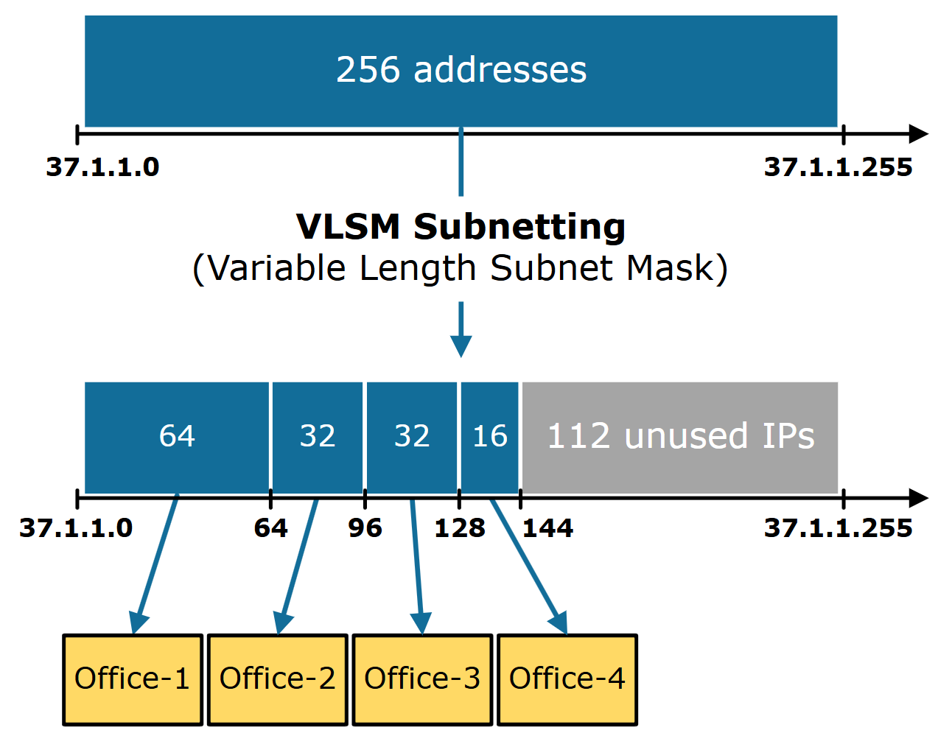
Variable Length Subnet Masking (VLSM)
VLSM stands for Variable Length Subnet Mask. VLSM is a subnetting technique that allows network admins to allocate IP addresses more efficiently using different subnet masks for different network segments. It provides greater flexibility in assigning IP addresses by creating subnets of varying sizes based on the specific needs and number of hosts in each subnet. This technique helps reduce the waste of IP addresses and better uses the available IP space.

Slide 60
Variable Length Subnet Masking (VLSM)
Notice that using VLSM, we are left with 112 free IP addresses that we can allocate to another location in the future. Compared to the FLSM approach, this method is much more efficient. The main idea is that VLSM allows us to divide an IP address space into subnets of varying sizes based on the specific requirements of each office. This helps to minimize the waste of IP addresses, as each subnet is assigned only the necessary number of IPs instead of using fixed-size subnets that may be too large or too small for the purpose.
On the other hand, the only downside of this approach is its complexity. The VLSM subnetting method requires more advanced planning, design, and administration than the FLSM approach. If we do not carefully plan in advance how we subnet our blocks of IP addresses, we can end up with IP address fragmentation, meaning some ranges of IP addresses may not be contiguous (more on this in the next lessons).

Slide 61
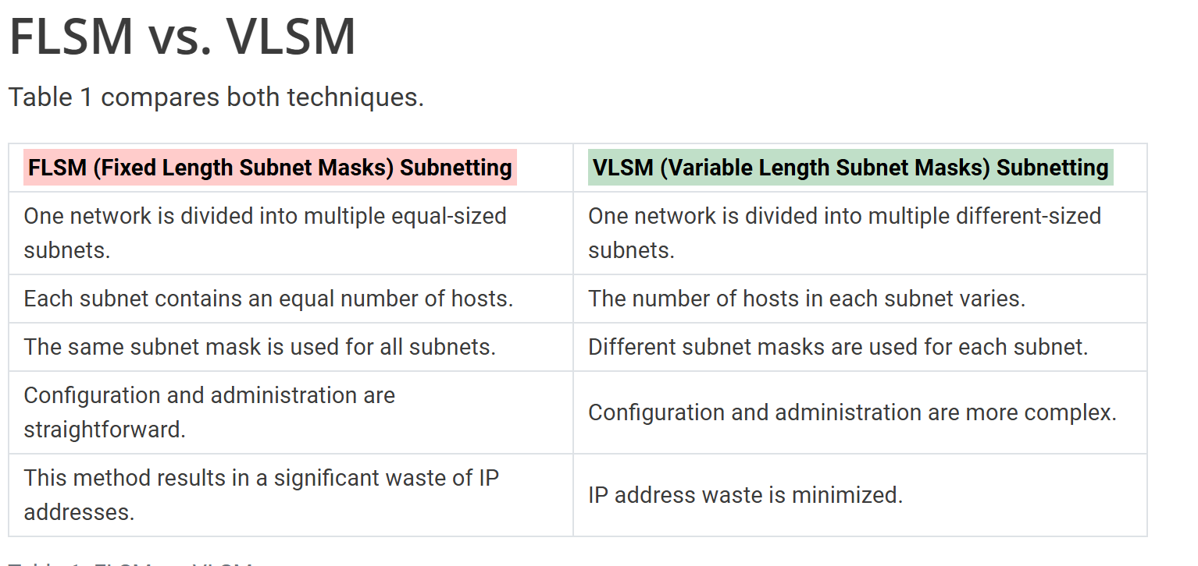
Variable Length Subnet Masking (VLSM)

